Slide 1
Women’s Safety in India

Slide 2
Overview
Problem statement:
Women safety is one of the most important aspect but lacks enough means to address it
Solutions involve many mobile apps today that send message – but there is no direct action invocation
Solution:
Our aim is to create a solution that helps reaching out to women in distress
The solution involves multiple means to achieve this:
Mobile app for the person in distress to send SOS signal
Central system that runs on the cloud and receives the location of person in distress
Police control room that has the console of the Central system get the distress signal and location and can prompt for action
Registered volunteers who receive a message with location of person in distress (if nearby)
Pair of drones stationed at certain location trigger into action and reach to victim location and provide visual tracking of victim and attacker

Slide 3
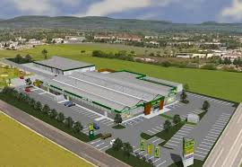
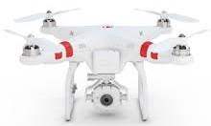


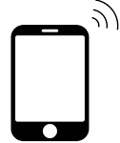

Solution workflow
Users install app on their mobile and register with their “Adhar” card also providing their registered location and mobile number. Optionally users can opt as volunteers to receive distress signal and location of person in distress if in nearby location to their registered location.
1. Victim presses “SOS” button (shake or emergency icon on locked screen or power button 5 times)
2. User location sent to Central system via Internet and SMS. (gps turned on on SOS to save power)
3. Central system sends Google map location of victim to Police control room and to volunteers nearby
4. Pair of drones at the nearest drone station start towards victim [In phase 1 these can driven manually from police control room and later phase can enhance this to automatically drive the drones to victim location].
Drones get charged at the drone station and also have solar charging.
5. Police control informs police officers at nearest police station / on patrol providing victim location and live data from drones
6. If attacker tries to run, one drone follows the attacker while other drone remains with the victim. Drones keep sending video to police control while mobile app of victim takes pictures and send them

Slide 4
Demo
User can register using mobile app installed on their smart phone
For demo, we have a set of users already registered
In a distress situation if a registered user needs help, user can press SOS button of app
The user location is sent to Central system on cloud
This launches a tracking screen on police control console showing victim location and drones location and their movement towards victim location
For this demo the tracking screen also shows that one volunteer responds to the distress signal and comes forward for help, also moving towards victim

Slide 5
Thank You

